Slide 1
Computer Vision
FALL 2020
Problem Set #2
Parin Patel
ppatel480@gatech.edu
Computer Vision @ GT

Slide 2
Traffic Light Detection
Coordinates and State:
Coordinates: (120, 136)
State: green
ps2-1-a-1.png

Slide 3
Traffic Light Detection
Coordinates and State:
Coordinates: 250, 438
State: green
ps2-1-a-2.png

Slide 4
Traffic Light Detection
Coordinates and State:
Coordinates: 380, 130
State: yellow
ps2-1-a-3.png

Slide 5
Traffic Light Detection
Coordinates and State:
Coordinates: 480, 630
State: red
ps2-1-a-4.png

Slide 6
Traffic Sign Detection - Do Not Enter
Coordinates: 346, 246
ps2-2-a-1.png

Slide 7
Traffic Sign Detection - Stop
Coordinates: 248, 547
ps2-2-a-2.png

Slide 8
Traffic Sign Detection - Construction
Coordinates: 396, 254
ps2-2-a-3.png

Slide 9
Traffic Sign Detection - Warning
Coordinates: 346, 751
ps2-2-a-4.png

Slide 10
Traffic Sign Detection - Yield
Coordinates: 188, 309
ps2-2-a-5.png

Slide 11
Multiple sign detection
Coordinates | Name
(148, 548) | stop
(350, 855) | construction
(448, 150) | no_entry
ps2-3-a-1.png

Slide 12
Multiple sign detection
Coordinates | Name
(336, 112) | traffic_light
(336, 236) | no_entry
(348,348) | stop
(334,507) | yield
(346, 651) | construction
(350, 805) | warning
ps2-3-a-2.png

Slide 13
Multiple sign detection with noise
Coordinates | Name
(333,157) | yield
(448,408) | warning
(244, 644) | no_entry
(158, 872) | traffic_light
ps2-4-a-1.png

Slide 14
Multiple sign detection with noise
Coordinates | Name
(358, 468) | traffic_light
(444,346) | no_entry
(198, 649) | stop
(334, 157) | yield
(196, 249) | construction
(343, 803) | warning
ps2-4-a-2.png

Slide 15
Challenge problem - A
Coordinates: (184, 462)
Name: no_entry
ps2-5-a-1

Slide 16
Challenge problem - A
Coordinates: (94, 342)
Name: yield
ps2-5-a-2

Slide 17
Challenge problem - A
Coordinates: (237, 653)
Name: Construction
ps2-5-a-3

Slide 18
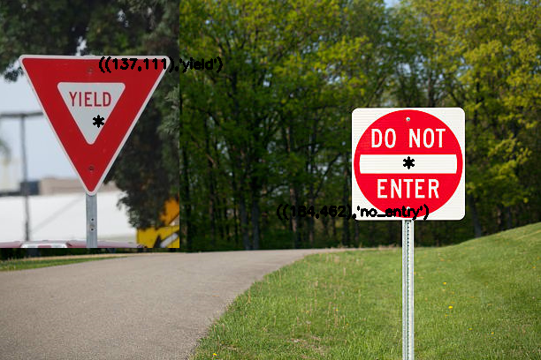
Challenge problem - B
Coordinates | Names
(137,111) | yield
(184, 462) | no_entry
ps2-5-b-1

Slide 19
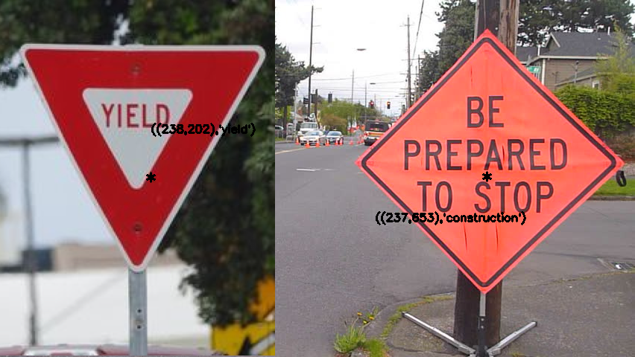
Challenge problem - B
Coordinates | Names
(238,202) | yield
(237,653) | construction
ps2-5-b-2

Slide 20
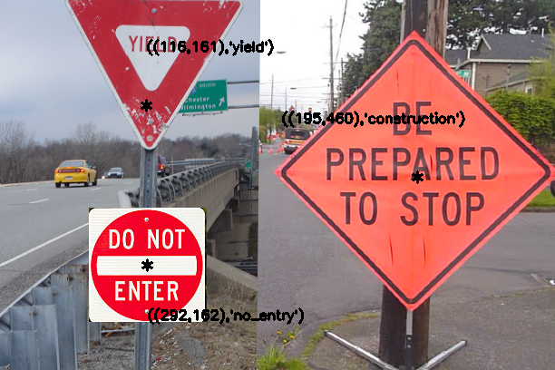
Challenge problem - B
Coordinates | Name
(116, 161) | yield
(292, 162) | no_entry
(195, 460) | construction
ps2-5-b-3

Slide 21
Challenge problem - Text
Describe what you had to do to adapt your code for this task. How does the difference between simulated and real-world images affect your method? If you used other functions/methods, explain why that was better (or why your previous implementation did not work)
As for simulated vs real world images difference go, I had to increase threshold for some of the distances due to the distortions even after I blurred and denoised the images.
Some images in real world, looks like they have proper lines and edges defined, but when passed through edge detection, it started giving broken edges, which affected polygon detection a lot.
A lot of extra lines were coming up in some of the real world images and that is why I had to add extra masks to get just the signs from their colors and then detect the centers. Whereas in simulated images, I was first detecting centers and then checking the colors.
Major changes I had to make and thus different functions:
Change threshold for proximal points of yield signs
HoughLinesP was detecting very small lines and thus I used HoughLines for construction and warning signs
As I was already checking for the colors in the beginning, it was easier to detect no_entry through checking for circles after applying the mask.

